Slide 1

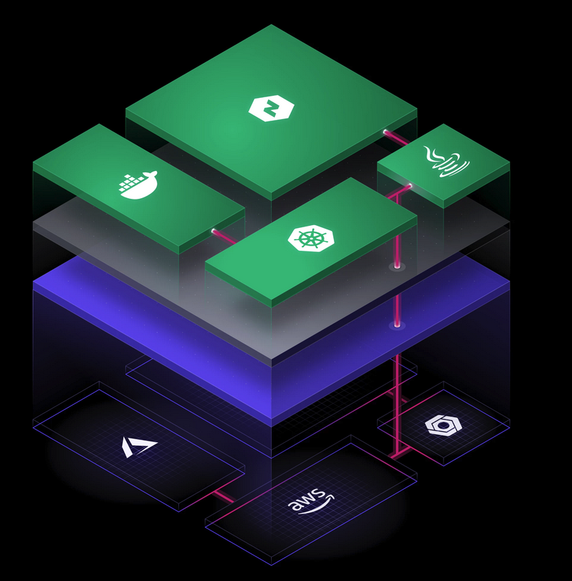
Realizing value of Hashicorp with: Business Continuity as Code

Slide 2

Pain-points for traditional Business Continuity / Disaster recovery models
Cost-overhead in duplicating infrastructure costs
Capacity Planning
Operational overhead and maintenance.
Inconsistent results from back-ups/fail-overs.
Technical challenges and technical debt.

Slide 3
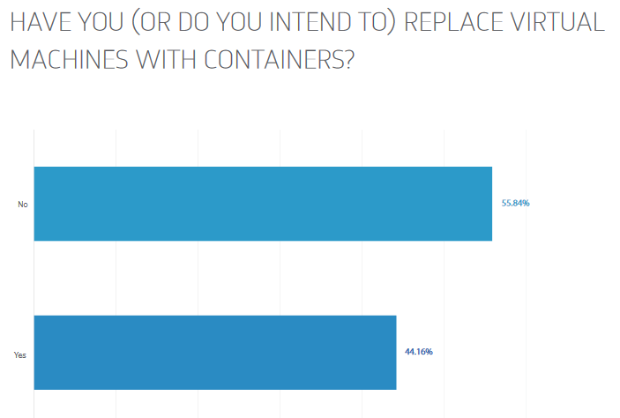
IT Infrastructure landscape
Within your organization – what percentage of applications run on containers vs. traditional VM infrastructure?
Diamanti study shows 55% of Enterprise Users still intend to keep their workloads on VM’s in 2018. (https://diamanti.com/wp-content/uploads/2018/07/WP_Diamanti_End-User_Survey_072818.pdf)

Slide 4

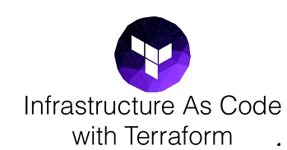
What IS Business Continuity as Code?
Business continuity is the process of creating systems of prevention and recovery to deal with potential threats to an Application. In addition to prevention, the goal is to permit ongoing operation, before and during execution of disaster recovery.
As Code is the process of managing and provisioning data-center resources through machine-readable definition files, rather than physical hardware configuration or interactive configuration tools.
+
Business Continuity as Code is designing for ongoing operations by leveraging Infrastructure as code.

Slide 5
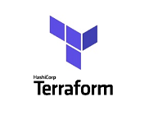
What is Terraform?
Terraform is a tool for building, changing, and versioning infrastructure safely and efficiently. Terraform can manage existing and popular service providers as well as custom in-house solutions.
Terraform is Declarative and abstracts the API calls needed to do the tasks.
Can be stored as JSON’s and maintained by version control.
Modular integrations with providers.

Slide 6


Why DO business Continuity as code?
Reduces Operating costs by storing duplicate Infrastructure as code.
Environments created on-demand and destroyed on demand. Only used, maintained, and paid for when needed.
Dependent infrastructure is identified in a structured manner.
Versioning and history in the Cloud.
Portability. Code can work with multiple providers.

Slide 7


Sounds good? How do to Achieve BC as Code.
Standardize Virtual Machines images using Packer.
Create Infrastructure as Code by defining required Data-Center resources in Terraform.
Store secrets for Cloud Providers and Guest VM access via Vault.
Test against a Cloud Provider of your choice. (AWS, Azure, GPC)
Store Configuration in a Git repository of choice.
Iterate, as needed to update or enhance Code as application needs change.

Slide 8
10 steps to extend LEGACY Private Datacenter Application to A Public Cloud Provider
High Level steps:
1. Establish a Site-to-Site VPN Connection
2. Provision a Database VM in Public Cloud instance
3. Create a Database cluster between Private Cloud DB and Public DB instance. (MySQL HA, SQL Always On, etc).
4. Ensure application configured to use Database cluster.
5. Power-down Private Cloud DB VM.
6. Ensure application still functions.
7. Power Down Private Cloud app Servers.
8. Terraform apply the Business Continuity TF file for “Application Servers”.
9. Test application now functions running entirely on Cloud Provider while maintaining Data Integrity.
10. If public facing application update DNS record/Load-Balancer pool.

Slide 9
Demo of Business Continuity as CODE
Demo of infrastructure a record being available in 2 regions in AWS.
How quickly it can be provisioned.

Slide 10
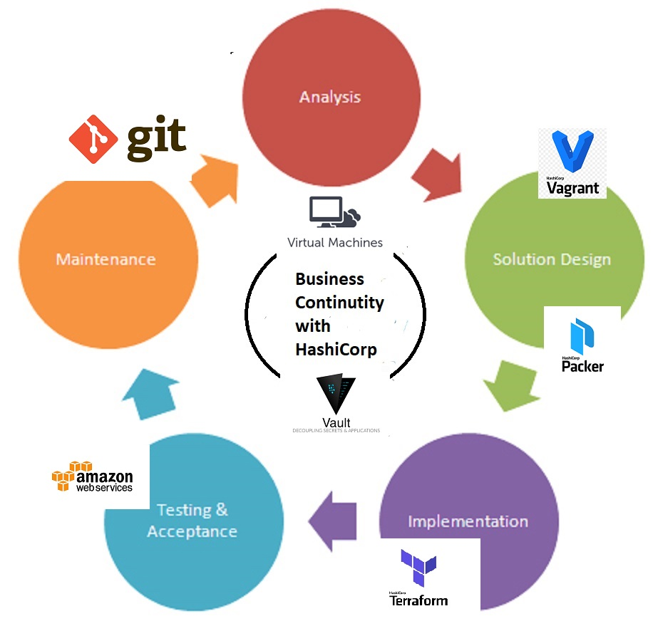
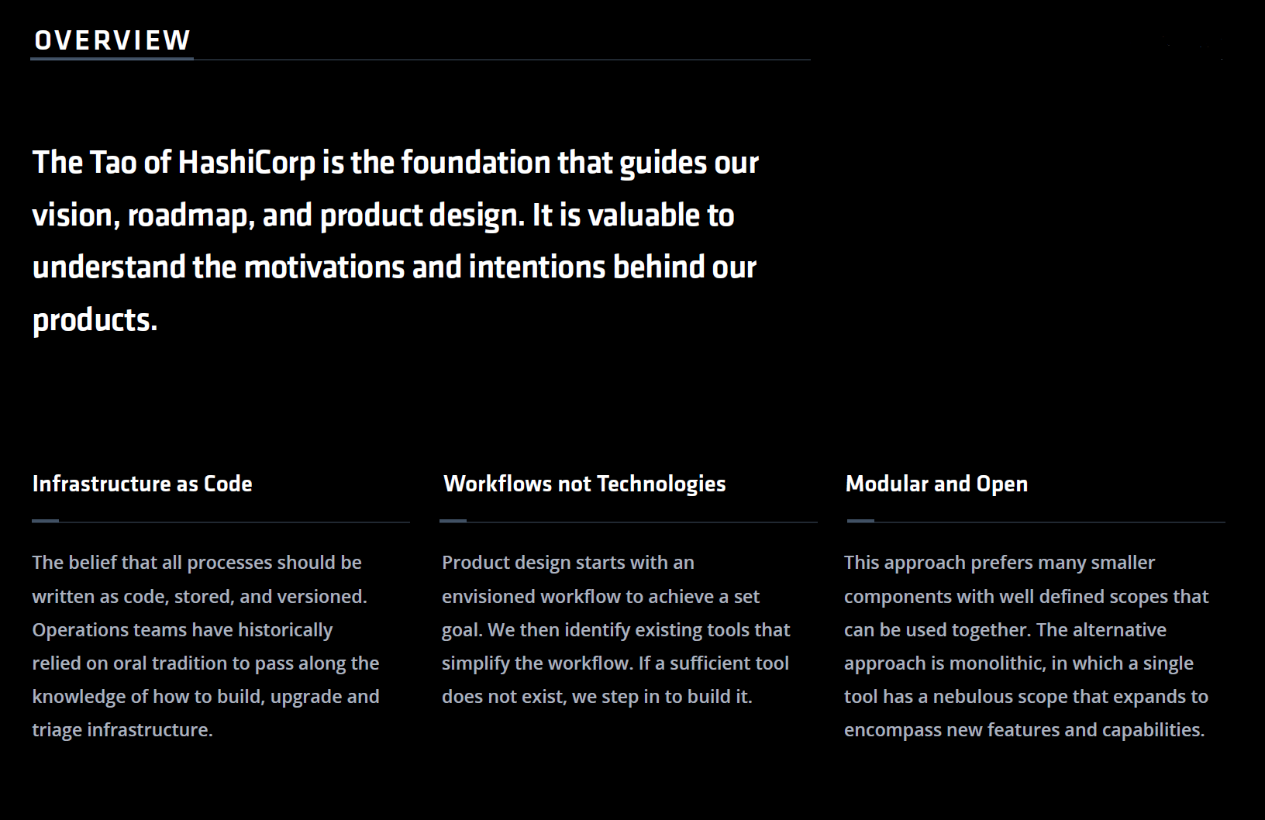
How Do Hashicorp products assist with Business Continuity as Code?
Note: All products have Open Source versions and content. Can access content and realize value.
See: https://github.com/hashicorp

Slide 11
What Value does Vault add?
Vault maintains Full User access logs of Secrets accessed.
It can store a variety of secrets including: AWS keys, SSH keys, and certificates.
Dynamic key generation allows of high rate of expiration and protection from “stolen” secrets.
When used in conjunction with Terraform and Infrastructure as Code it prevents Secrets from being stored in Variable files, State files, or Git Repos where they can be compromised.
Reference this deep dive video: https://www.youtube.com/watch?time_continue=1740&v=fOybhcbuxJ0

Slide 12
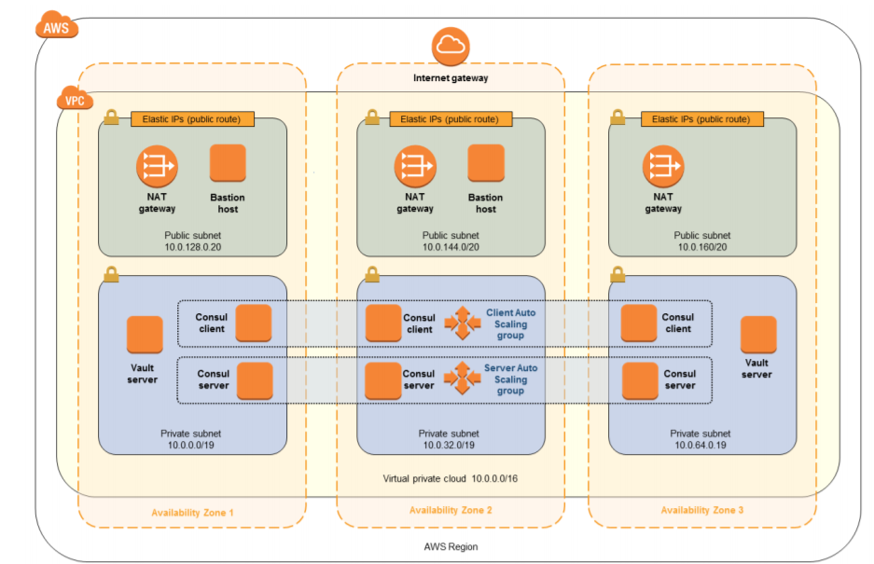
Creating a Highly Available Vault environment
Vault acts as secret Management Service.
3 Nodes across availability zones in provider of your choice.
Demo provisioning and using vault to create and store secrets.
Talk about the role Consul plays and how Consul can be used to replace load-balancing.
Reference Architecture

Slide 13
Demo Vault
Adding a Secret key
Show integration with Terraform
Look at Full Enterprise scaled instance in AWS
Also see repo: https://github.com/hashicorp/vault/tree/master/terraform/aws

Slide 14
Using Packer to Create Custom Images
Super fast infrastructure deployment. Packer images allow you to launch completely provisioned and configured machines in seconds, rather than several minutes or hours. This benefits not only production, but development as well, since development virtual machines can also be launched in seconds, without waiting for a typically much longer provisioning time.
Multi-provider portability. Because Packer creates identical images for multiple platforms, you can run production in AWS, staging/QA in a private cloud like OpenStack, and development in desktop virtualization solutions such as VMware or VirtualBox. Each environment is running an identical machine image, giving ultimate portability.
Improved stability. Packer installs and configures all the software for a machine at the time the image is built. If there are bugs in these scripts, they'll be caught early, rather than several minutes after a machine is launched.
Greater testability. After a machine image is built, that machine image can be quickly launched and smoke tested to verify that things appear to be working. If they are, you can be confident that any other machines launched from that image will function properly.

Slide 15

Summary
Benefits to IT and the Business:
Save money by provisioning resources on demand (in event of disaster)
Structure and define “Infrastructure as Code” to gain consistency and portability.
Built in Security in the Design
Transition to next-gen Applications using Hashicorp products

Slide 16
Questions
?

